Slide 1

Sync+ 2.0
Phase4_U625ICA_R12 HF7 –Baidu
Baidu
Updated on 2022-10-24
Desired Outcome
Awareness
Decision
Escalation Help
Think
Point of view
Plan to Implement
Implement

Slide 2
{U625ICA_R12HF7} Software overall status {Green}
Software key info
Refer SWAD for the details:
MCU version: 20220726_502_PRO
SOC User version: 220221021_0814_B2F27_R12.PRO.HF7
Verification scope and method:
{Full verification} executed with pass rate 100%, 0 P0&P1 and 0 P2 issues found and not fixed. Refer test report for detail.
Main changes compared with previous version, refer RN for the details, highlights listed below:
OpenJIRA IG/G issues with risk evaluation – refer slide 3
Memory leak, VR project test – refer slide 4、5、6
Performance test – refer slide 7
Notes:
Add P1 weekly burn down chart

Slide 3
{U625ICA_R12HF7} Open IG/G with risk evaluation
NA
Notes:
Add P1 weekly burn down chart

Slide 4
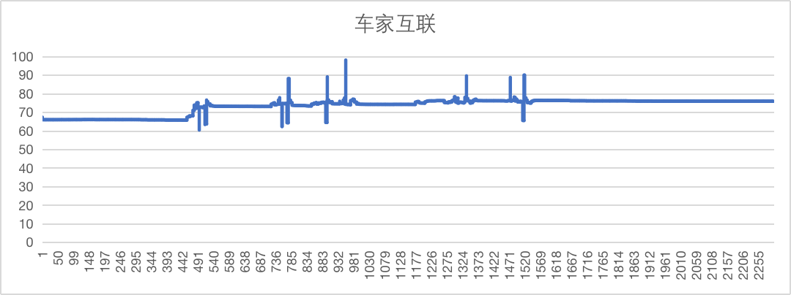
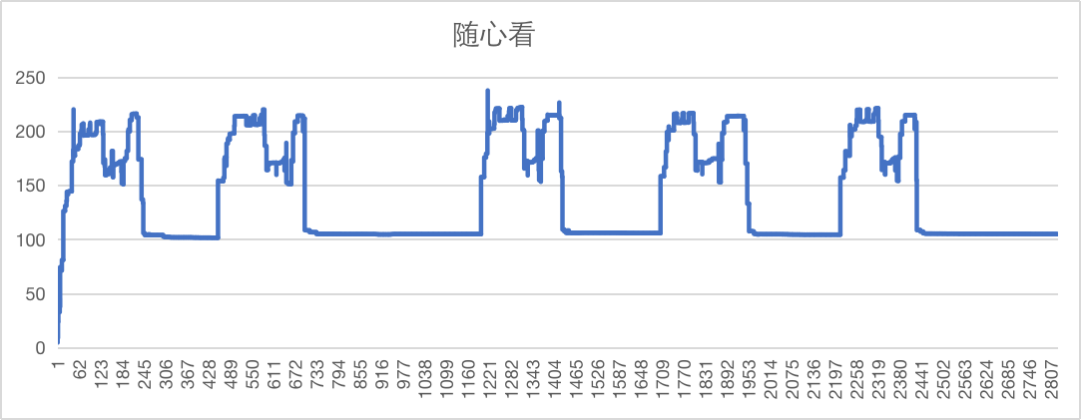
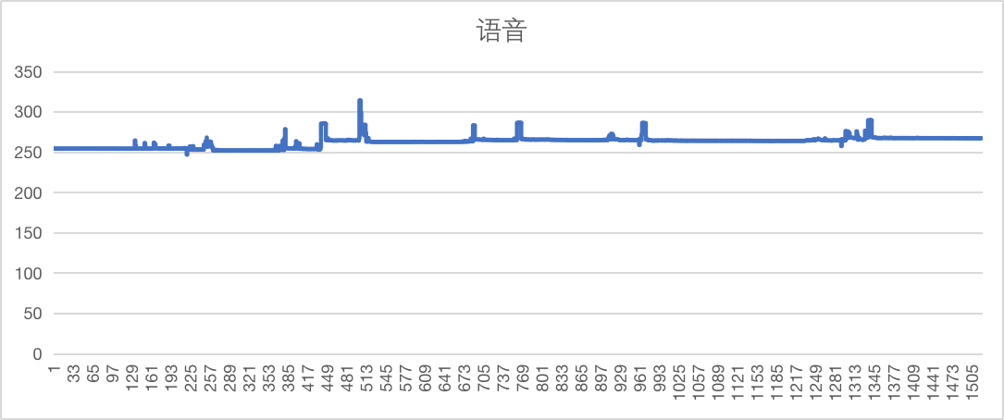
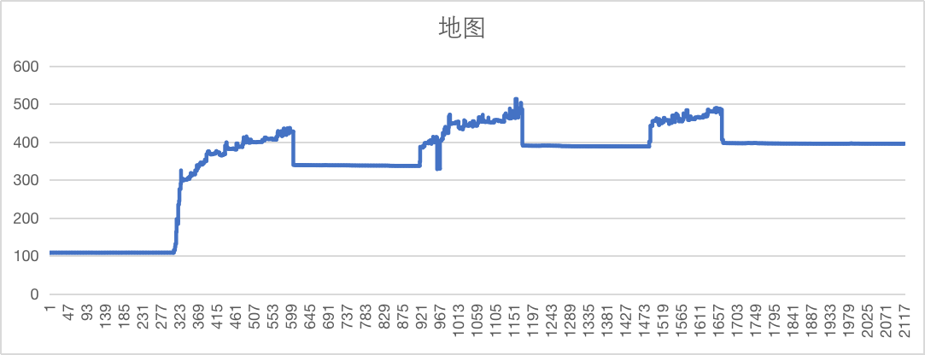
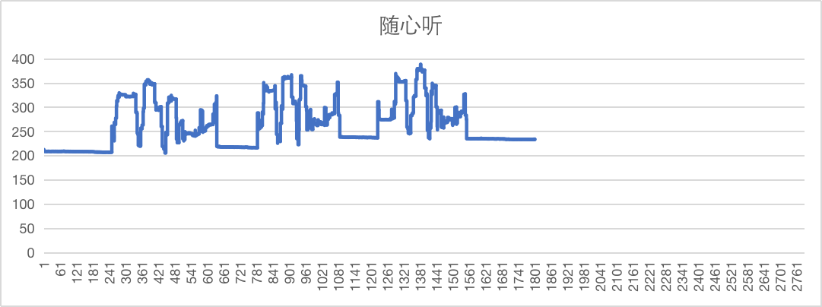
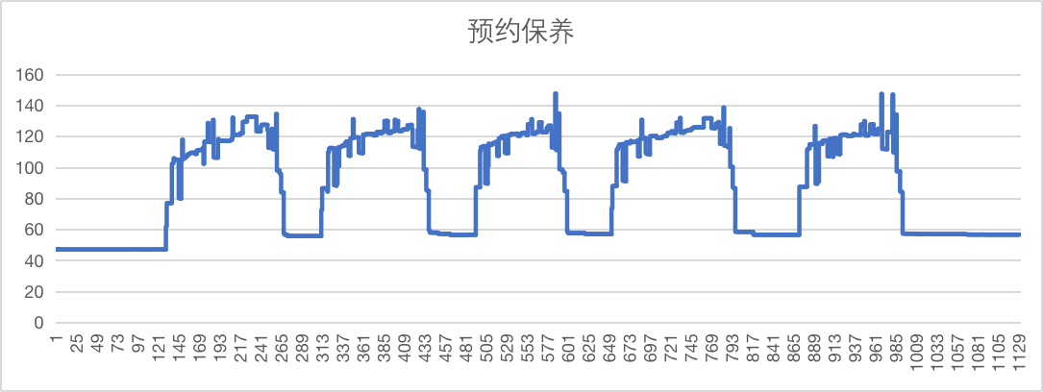
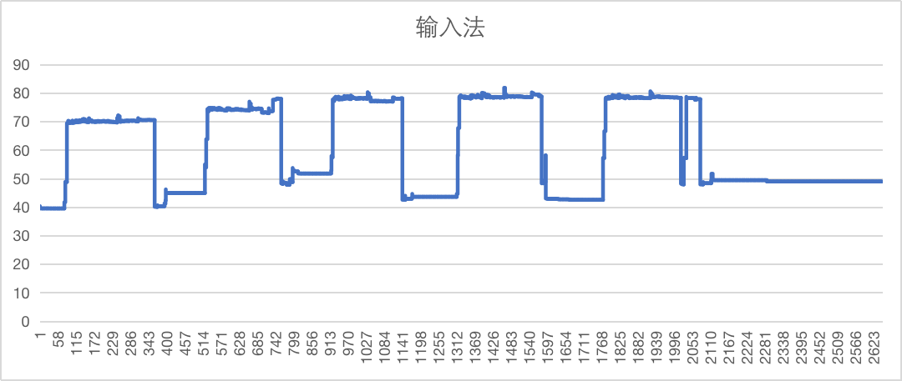
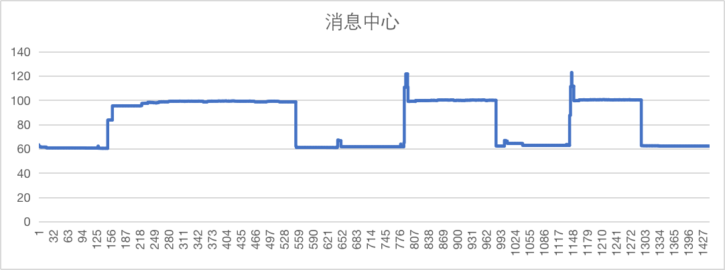
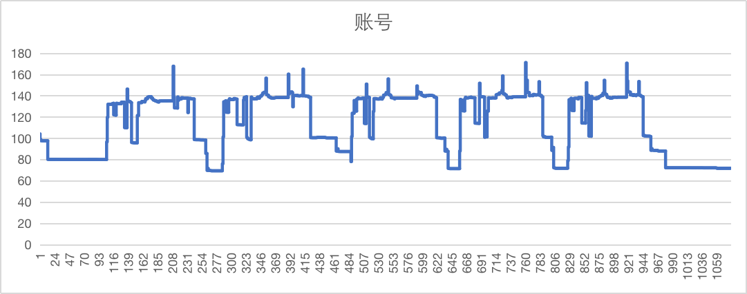
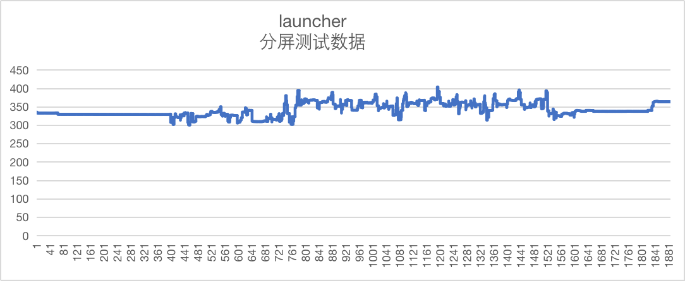
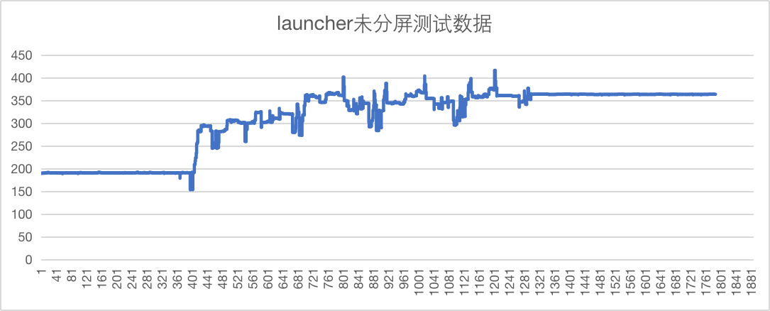
{U625ICA_R12HF7} 内存泄漏专项测试

Slide 5
{U625ICA R12 高配} 语音专项测试
唤醒词唤醒率： Pass
AI能力 | 指标项 | 通过标准 | 实测结果 | 测试结论
暂停播放 | 低噪 | 85% | 100% | PASS
 | 中噪 | 85% | 100% | PASS
 | 高噪 | 80% | 100% | PASS
继续播放 | 低噪 | 85% | 100% | PASS
 | 中噪 | 85% | 100% | PASS
 | 高噪 | 80% | 100% | PASS
上一首 | 低噪 | 85% | 100% | PASS
 | 中噪 | 85% | 99% | PASS
 | 高噪 | 80% | 98% | PASS
上一曲 | 低噪 | 85% | 99% | PASS
 | 中噪 | 85% | 95% | PASS
 | 高噪 | 80% | 99% | PASS
下一首 | 低噪 | 85% | 99% | PASS
 | 中噪 | 85% | 98% | PASS
 | 高噪 | 80% | 93% | PASS
下一曲 | 低噪 | 85% | 99% | PASS
 | 中噪 | 85% | 100% | PASS
 | 高噪 | 80% | 99% | PASS
接听电话 | 低噪 | 85% | 98% | PASS
 | 中噪 | 85% | 99% | PASS
 | 高噪 | 80% | 98% | PASS
挂断电话 | 低噪 | 85% | 100% | PASS
 | 中噪 | 85% | 100% | PASS
 | 高噪 | 80% | 100% | PASS
跟随模式 | 低噪 | 85% | 99% | PASS
 | 中噪 | 85% | 100% | PASS
 | 高噪 | 80% | 100% | PASS
车头朝上 | 低噪 | 85% | 100% | PASS
 | 中噪 | 85% | 100% | PASS
 | 高噪 | 80% | 100% | PASS
正北模式 | 低噪 | 85% | 100% | PASS
 | 中噪 | 85% | 98% | PASS
 | 高噪 | 80% | 99% | PASS
放大地图 | 低噪 | 85% | 100% | PASS
 | 中噪 | 85% | 99% | PASS
 | 高噪 | 80% | 98% | PASS
缩小地图 | 低噪 | 85% | 99% | PASS
 | 中噪 | 85% | 99% | PASS
 | 高噪 | 80% | 91% | PASS
打开路况 | 低噪 | 85% | 100% | PASS
 | 中噪 | 85% | 100% | PASS
 | 高噪 | 80% | 100% | PASS
关闭路况 | 低噪 | 85% | 99% | PASS
 | 中噪 | 85% | 100% | PASS
 | 高噪 | 80% | 99% | PASS
开始导航 | 低噪 | 85% | 94% | PASS
 | 中噪 | 85% | 100% | PASS
 | 高噪 | 80% | 100% | PASS
查看全程 | 低噪 | 85% | 98% | PASS
 | 中噪 | 85% | 99% | PASS
 | 高噪 | 80% | 98% | PASS
继续导航 | 低噪 | 85% | 99% | PASS
 | 中噪 | 85% | 100% | PASS
 | 高噪 | 80% | 96% | PASS
上一页 | 低噪 | 85% | 100% | PASS
 | 中噪 | 85% | 98% | PASS
 | 高噪 | 80% | 99% | PASS
下一页 | 低噪 | 85% | 100% | PASS
 | 中噪 | 85% | 99% | PASS
 | 高噪 | 80% | 99% | PASS
确定 | 低噪 | 85% | 100% | PASS
 | 中噪 | 85% | 100% | PASS
 | 高噪 | 80% | 100% | PASS
取消 | 低噪 | 85% | 100% | PASS
 | 中噪 | 85% | 100% | PASS
 | 高噪 | 80% | 100% | PASS
第一个 | 低噪 | 85% | 98% | PASS
 | 中噪 | 85% | 98% | PASS
 | 高噪 | 80% | 100% | PASS
第二个 | 低噪 | 85% | 100% | PASS
 | 中噪 | 85% | 91% | PASS
 | 高噪 | 80% | 100% | PASS
第三个 | 低噪 | 85% | 95% | PASS
 | 中噪 | 85% | 99% | PASS
 | 高噪 | 80% | 99% | PASS
唤醒词 | 指标项 | 通过标准 | 实测结果 | 测试结论
小度小度 | 低噪 | 92% | 99% | PASS
 | 中噪 | 90% | 99% | PASS
 | 高噪 | 85% | 99% | PASS
你好福特 | 低噪 | 92% | 100% | PASS
 | 中噪 | 90% | 100% | PASS
 | 高噪 | 85% | 98% | PASS

Slide 6
{U625ICA R12 低配} 语音专项测试
唤醒词唤醒率： Pass
AI能力 | 指标项 | 通过标准 | 实测结果 | 测试结论
暂停播放 | 低噪 | 85% | 100% | PASS
 | 中噪 | 85% | 99% | PASS
 | 高噪 | 80% | 99% | PASS
继续播放 | 低噪 | 85% | 100% | PASS
 | 中噪 | 85% | 96% | PASS
 | 高噪 | 80% | 96% | PASS
上一首 | 低噪 | 85% | 95% | PASS
 | 中噪 | 85% | 96% | PASS
 | 高噪 | 80% | 90% | PASS
上一曲 | 低噪 | 85% | 90% | PASS
 | 中噪 | 85% | 91% | PASS
 | 高噪 | 80% | 91% | PASS
下一首 | 低噪 | 85% | 99% | PASS
 | 中噪 | 85% | 95% | PASS
 | 高噪 | 80% | 96% | PASS
下一曲 | 低噪 | 85% | 95% | PASS
 | 中噪 | 85% | 88% | PASS
 | 高噪 | 80% | 91% | PASS
接听电话 | 低噪 | 85% | 100% | PASS
 | 中噪 | 85% | 98% | PASS
 | 高噪 | 80% | 100% | PASS
挂断电话 | 低噪 | 85% | 100% | PASS
 | 中噪 | 85% | 100% | PASS
 | 高噪 | 80% | 100% | PASS
跟随模式 | 低噪 | 85% | 98% | PASS
 | 中噪 | 85% | 99% | PASS
 | 高噪 | 80% | 98% | PASS
车头朝上 | 低噪 | 85% | 98% | PASS
 | 中噪 | 85% | 99% | PASS
 | 高噪 | 80% | 96% | PASS
正北模式 | 低噪 | 85% | 98% | PASS
 | 中噪 | 85% | 99% | PASS
 | 高噪 | 80% | 96% | PASS
放大地图 | 低噪 | 85% | 93% | PASS
 | 中噪 | 85% | 91% | PASS
 | 高噪 | 80% | 91% | PASS
缩小地图 | 低噪 | 85% | 93% | PASS
 | 中噪 | 85% | 96% | PASS
 | 高噪 | 80% | 91% | PASS
打开路况 | 低噪 | 85% | 100% | PASS
 | 中噪 | 85% | 100% | PASS
 | 高噪 | 80% | 100% | PASS
关闭路况 | 低噪 | 85% | 100% | PASS
 | 中噪 | 85% | 98% | PASS
 | 高噪 | 80% | 100% | PASS
开始导航 | 低噪 | 85% | 98% | PASS
 | 中噪 | 85% | 99% | PASS
 | 高噪 | 80% | 98% | PASS
查看全程 | 低噪 | 85% | 96% | PASS
 | 中噪 | 85% | 98% | PASS
 | 高噪 | 80% | 95% | PASS
继续导航 | 低噪 | 85% | 94% | PASS
 | 中噪 | 85% | 100% | PASS
 | 高噪 | 80% | 95% | PASS
上一页 | 低噪 | 85% | 95% | PASS
 | 中噪 | 85% | 94% | PASS
 | 高噪 | 80% | 94% | PASS
下一页 | 低噪 | 85% | 89% | PASS
 | 中噪 | 85% | 98% | PASS
 | 高噪 | 80% | 94% | PASS
确定 | 低噪 | 85% | 91% | PASS
 | 中噪 | 85% | 100% | PASS
 | 高噪 | 80% | 94% | PASS
取消 | 低噪 | 85% | 93% | PASS
 | 中噪 | 85% | 93% | PASS
 | 高噪 | 80% | 96% | PASS
第一个 | 低噪 | 85% | 100% | PASS
 | 中噪 | 85% | 100% | PASS
 | 高噪 | 80% | 98% | PASS
第二个 | 低噪 | 85% | 94% | PASS
 | 中噪 | 85% | 93% | PASS
 | 高噪 | 80% | 95% | PASS
第三个 | 低噪 | 85% | 94% | PASS
 | 中噪 | 85% | 99% | PASS
 | 高噪 | 80% | 88% | PASS
唤醒词 | 指标项 | 通过标准 | 实测结果 | 测试结论
小度小度 | 低噪 | 92% | 98% | PASS
 | 中噪 | 90% | 98% | PASS
 | 高噪 | 85% | 95% | PASS
你好福特 | 低噪 | 92% | 100% | PASS
 | 中噪 | 90% | 100% | PASS
 | 高噪 | 85% | 100% | PASS

Slide 7
{U625ICA R12 HF7 低配} 语音专项测试
误唤醒测试：Pass
U625高配 | 误唤醒测试 | AI能力 | 测试时长 | 通过标准 | 实测结果 | 测试结论 | 备注
 |  | 小度小度 | 静态测试 （互相聊天对话） 4.5小时 | <0.3次/h | 0 | PASS
 |  | 你好福特 |  | <1.2次/h | 0 | PASS
 |  | 小度小度 | 播放爱情公寓5 20小时 | <0.3次/h | 0 | PASS
 |  | 你好福特 |  | <1.2次/h | 0 | PASS
U625低配 | 误唤醒测试 | AI能力 | 测试时长 | 通过标准 | 实测结果 | 测试结论 | 备注
 |  | 小度小度 | 静态测试 （互相聊天对话） 4.5小时 | <0.3次/h | 1 | PASS
 |  | 你好福特 |  | <1.2次/h | 0 | PASS
 |  | 小度小度 | 播放爱情公寓5 20小时 | <0.3次/h | 0 | PASS
 |  | 你好福特 |  | <1.2次/h | 0 | PASS

Slide 8
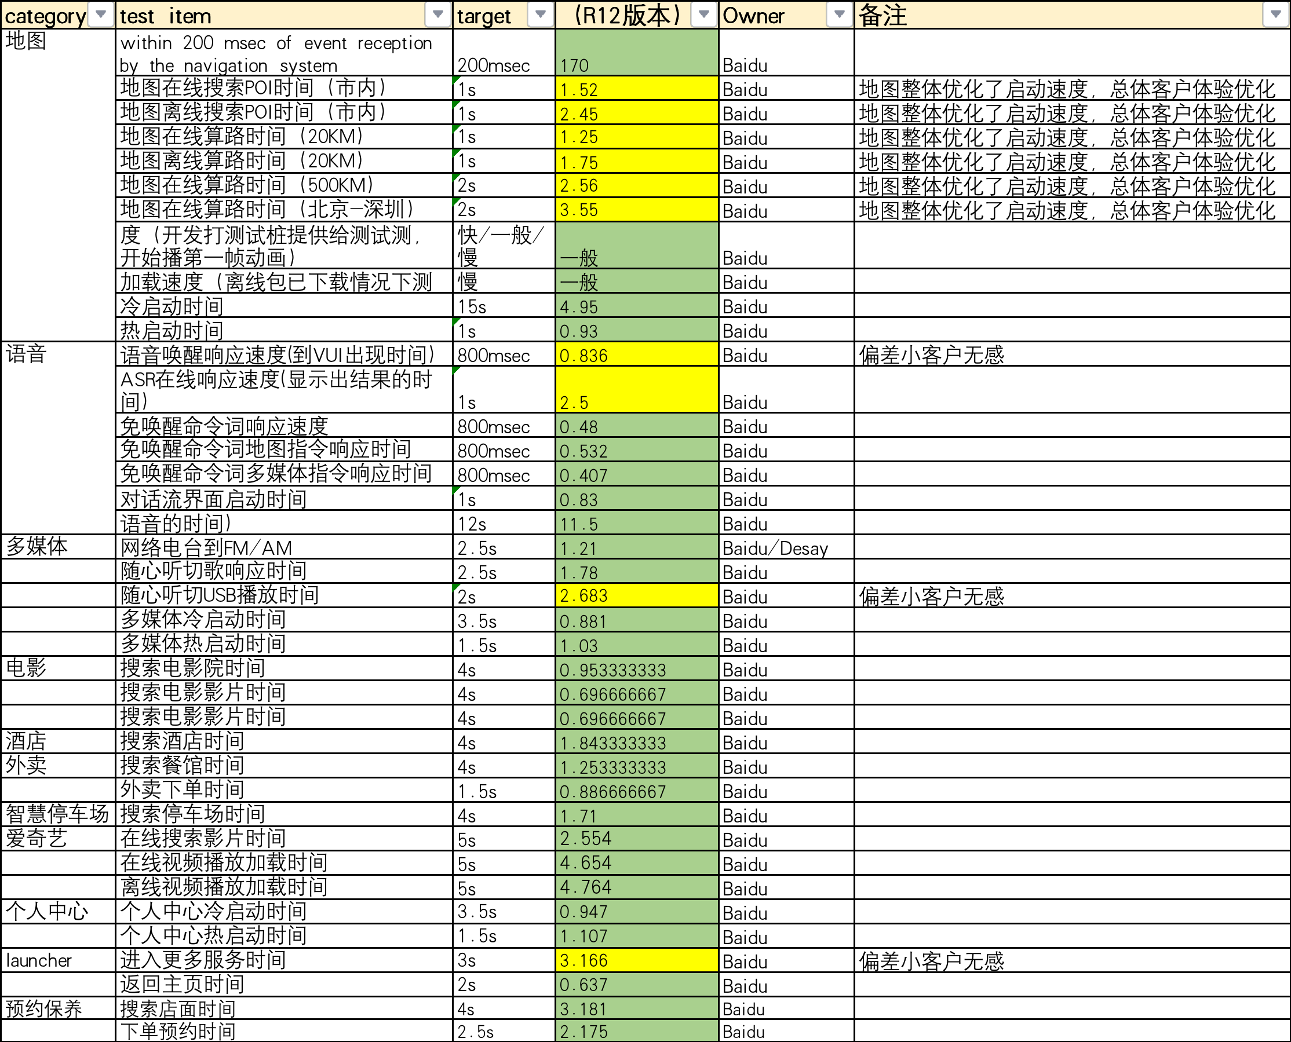
{625ICA R12 HF7 } 性能测试

Slide 9
关键字 | 概要 | 问题发生概率 | Affect version | 影响范围评估 | Rootcause | PCA | Status | 临时恢复措施 | 修复版本
APIMCIS-32080 | MMOTA_China:After upgrade SYNC+SW success, FP account is lost | 偶现 | NA | 只在测试环境，OTA之前账号是沙盒环境，升级后是PROD环境才会产生，对客户OTA升级无影响 | OTA升级改变了账号环境，导致退出登陆 | NA | G | 重新登陆 | NA
APIMCIS-32086 | [U625ICA][地图][偶现]删除公司地址后点击刷新图标，又出现公司地址 | 偶现 | R12 HF7 | TBD | TBD | TBD | Y | 再次进行删除 | TBD
APIMCIS-32027 | [U625ICA][随心听][必现]分屏，副驾播歌，仪表切音源，随心听伪双开，且偶现一次FM和USB混音 | 必现 | R12HF5 | R12HF5 | launcher福特在线卡片引起的crash已在apk2.5.1.2,对应ROM解决的版本B2F27_R12HF6, | 百度修复了widget crash问题 | G | 后台结束进程重启 | R12HF7
APIMCIS-26746 | Phase4:Failure to check airline ticket information by voice | 单个航班号必现 | ALL | ALL | 语音引擎识别航班号增加了一个空格 | NA | Y | NA | 只针对单个航班号出现，建议维持现状
APIMCIS-29190 | [FP4.1.8][Android][IOS]Bind the baidu account with binding relationship, click to activate the vehicle, and the auth pop-up box will be launched directly 绑定存在绑定关系的百度账号，点击激活车辆会直接发起auth弹框 | 必现 | R12 HF7 | 非常规操作，对客户影响不大 | 需要Ford Inhouse team出方案，目前是Ford Meng Meiqi在推进中 | TBD | G | 不需要 | 取决于福特确定的方案
APIMCIS-30342 | [U625ICA][必现][语音]音乐播放过程中，语音“重新播放”，音乐暂停 | 必现 | ALL | 必现问题，目前未见其他渠道反馈，评估是低风险问题 | 免唤醒不包含“重新播放”，免唤醒指令包含：暂停播放、继续播放、上一首、上一曲、下一首、下一曲。 在操作中，“重新播放”误识别成“暂停播放”，误唤醒，最终音乐暂停。需优化语音模型处理 |  | G | 不需要 | NA
APIMCIS-29570 | CLONE - Phase4:[必现]消息中心下拉效果未做到渐隐渐显 | 必现 | R12 HF7 | ALL | 需求问题，R13消息中心合入 | 基于需求开发新功能 | G | NA | R13

